Slide 1
PowerPoint Inservice
July 21, 2016

Slide 2
Preparing to Add Narration
Most laptop computers have a built in microphone but most desktop computers do not.
An inexpensive (<$15) headset with a microphone will work fine but a more expensive headset will improve sound quality and reduce/eliminate background noise.
Record separate narration files for each slide
Multiple, smaller audio files load more quickly than one large one.
Narration will be tied directly to the slide being viewed. In a timed presentation, if a slide’s timing and the narration get out of sync, it’ll get back in tandem on the next slide

Slide 3
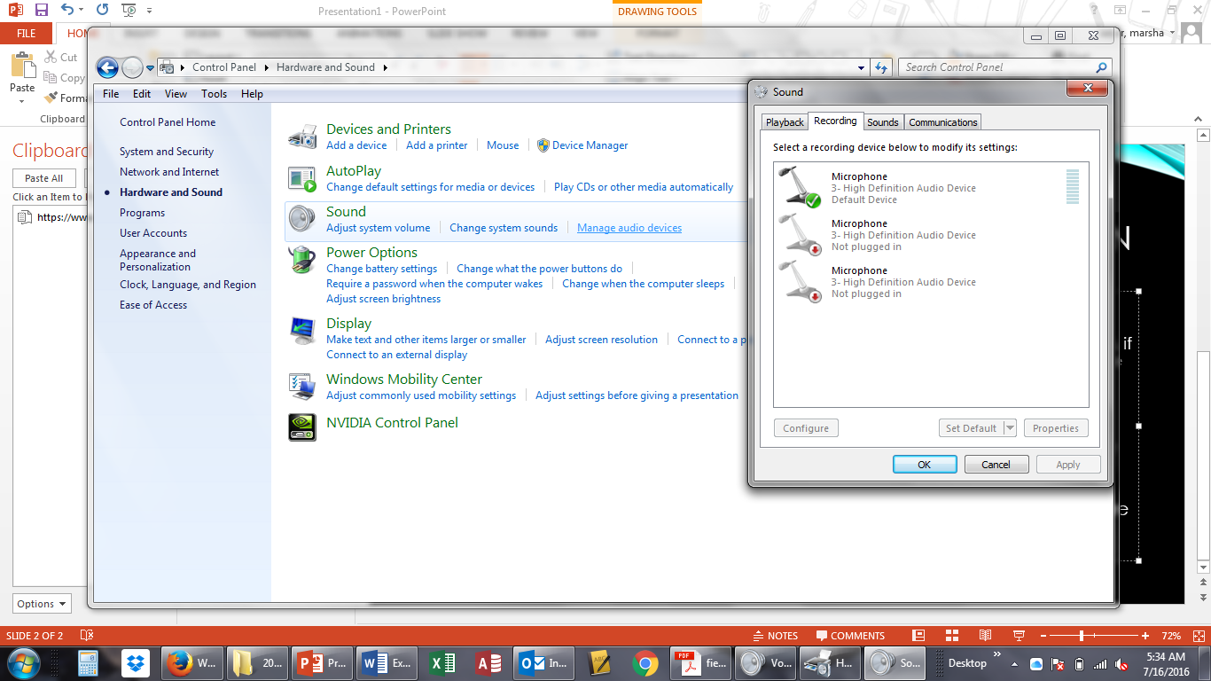
Check Your Audio Settings
Start Menu
Control Panel
Hardware and Sound
Manage Audio Devices
Recording

Slide 4
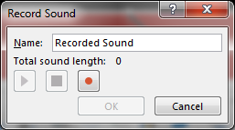
Recording Audio in PPT
Insert
Audio
Record Audio

Slide 5
Recording Audio in Windows
Start Menu
Enter “Sound Recorder” in search box
Record and save audio file
Insert, Audio, Insert Audio on My PC…

Slide 6
Removing Picture Background
Select picture
Picture Tools Format
Remove Background
Check bounding box and mark areas to keep or remove

Slide 7
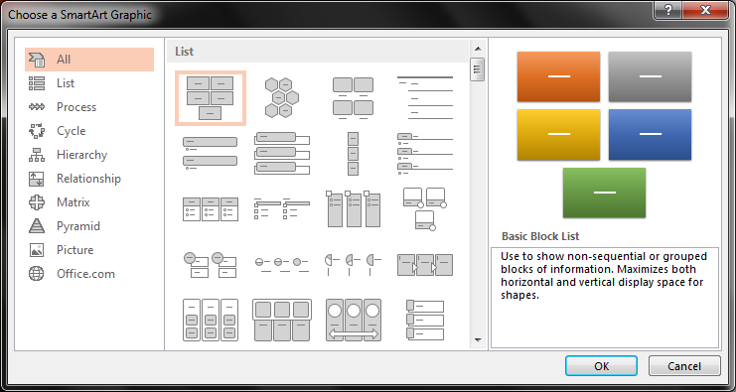
Smart Art

Slide 8
Rehearse Timings
Complete entire presentation including any transitions and animations
Slide Show, Rehearse Timings (not Record Slide Show), then click through the presentation as you want it to display.

Slide 9
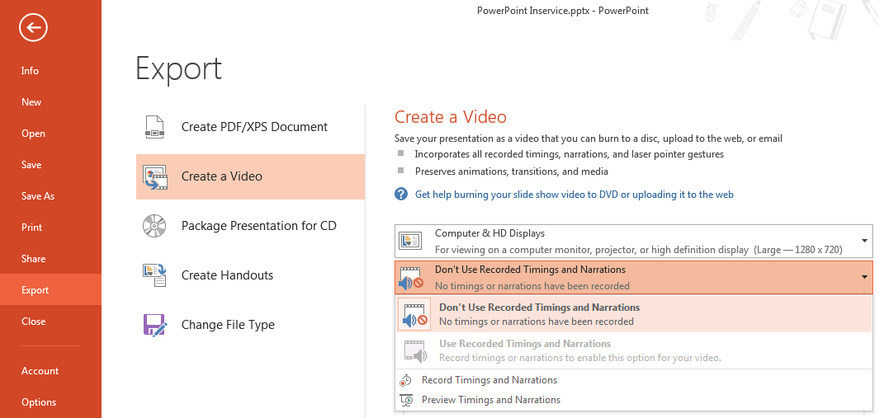
Save As a Video File
Complete all narrations and timings (using Rehearse Timings)
File, Export, Create a Video
Choose to “Use Recorded Timings and Narrations”
Saves as an MP4 video file

